Slide 1

NodeCoin
SQLite vs Neo4j on real Bitcoin data
A relational and a graph database, compared on 977 blocks
Damiano Spadaccini · 1986173
Data Management 2025/2026

Slide 2
What this project is
Which queries, and at what scale, does a graph DB handle better than a relational DB?
1
2
8
4
dataset
models
queries
sizes
977 real blocks
7 tables · 1 graph
SQL + Cypher
same protocol
Neither model wins everywhere
NodeCoin · SQLite vs Neo4j
Data Management 2025/2026
Pagina 2

Slide 3
How the data gets there
1 PARSE
2 LOAD
3 CHECK
4 CLUSTER
5 MEASURE
.blk → JSONL
1 file → 2 DBs
16 metrics match
addresses → wallets
8 queries × 2
THE DATASET · one week of the real chain, 13-20 May 2026
977
4.31 M
9.89 M
2.55 M
blocks
transactions
outputs
addresses
THE JSONL FILE · one line = one block
{"hash": "0000…12c3", "prev_hash": "0000…e871", "timestamp": 1778693452,
"transactions": [
{"txid": "4013…0b01", "size": 315,
"inputs": [{"prev_txid": "f6fd…8a61", "prev_index": 3}],
"outputs": [{"index": 0, "address": "bc1qs6e7…py4dy", "value": 133608}, …]},
… ]}
prev_txid + prev_index
the link to the spent output
→ SPENDS in the graph
NodeCoin · SQLite vs Neo4j
Data Management 2025/2026
Pagina 3

Slide 4
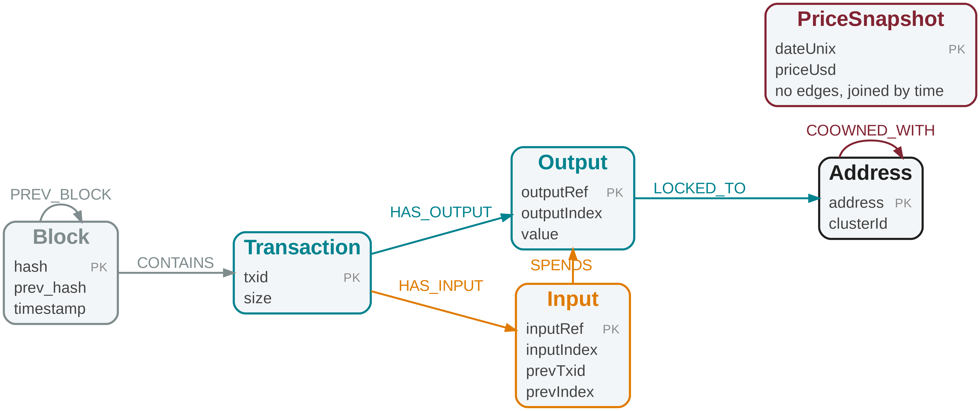
Same domain, two models
SQLite · 7 tables PK primary key FK foreign key
Neo4j · 6 node types, 7 relationships
blocks
transactions
tx_inputs
hash PK
prev_hash
timestamp
txid PK
block_hash FK
size
txid PK FK
input_index PK
prev_txid
prev_output_index
addresses
tx_outputs
address PK
txid PK FK
output_index PK
address FK
value
address_clusters
address PK FK
cluster_id
price_history
date_unix PK
price_usd
address_clusters written by the clustering
price_history external source, joined by date
clusterId, COOWNED_WITH written by the clustering
PREV_BLOCK older → newer, opposite of prev_hash
Outputs and inputs are entities
Nothing derived is stored
FK only where the data guarantees it
key = (txid, index), no id of its own
money path Tx → Output → Input → Tx
same path in SQL and in the graph
fee, spent, height, orphan
computed at query time
no FK input → output
coinbase, outputs before the window
NodeCoin · SQLite vs Neo4j
Data Management 2025/2026
Pagina 4

Slide 5
Results on the full dataset
THE QUESTION
SQLITE
NEO4J
FASTER
Q1
How much fee did each transaction pay?
61.5 s
24.6 s
Neo4j 2.5x
Q2
Which outputs are still unspent?
12.5 s
9.4 s
Neo4j 1.3x
Q3
How much does each address hold?
40.3 s
10.8 s
Neo4j 3.7x
Q4
Where did one address's money go?
9.7 s
13.8 s
SQLite 1.4x
Q5
Which addresses receive the most?
9.6 s
9.0 s
tie
Q6
Which blocks are on the main chain?
2.1 ms
17.7 ms
SQLite 8.4x
Q7
How much does each wallet hold?
not available
12.3 s
Neo4j only
Q8
What is each transaction worth in USD?
16.7 s
12.4 s
Neo4j 1.3x
Neo4j wins 5
SQLite wins 2
tie 1
only Neo4j answers Q7
NodeCoin · SQLite vs Neo4j
Data Management 2025/2026
Pagina 5

Slide 6
How I measured
EVERY QUERY, ON BOTH ENGINES
run 0
run 1
run 2
run 3
median
warm-up, thrown away
timed
timed
timed
the number in the table
Timeout
Scalability
Timer covers all rows
120 s SQLite · 90 s Neo4j
too slow → recorded as timeout
4 sizes
50 · 200 · 500 · 977 blocks
t0 = time.perf_counter()
cur = conn.execute(sql)
cur.fetchall() # every row
t = time.perf_counter() - t0
Neo4j · result.consume()
Limits 1 laptop · 15 GiB RAM · 8 GB heap for Neo4j · SQLite in-process, Neo4j server (+1.3 ms per query)
NodeCoin · SQLite vs Neo4j
Data Management 2025/2026
Pagina 6

Slide 7
Where the graph wins
THE QUESTION
GAP
SQLITE
NEO4J
Q3
How much does each address hold?
3.7x
2 GROUP BY + 1 JOIN over millions of rows
1 pass, checks SPENDS on each output
Q1
How much fee did each transaction pay?
2.5x
JOIN on 2 columns to find each input's value
follows SPENDS to the output
Q2
Which outputs are still unspent?
1.3x
looks for an input row that is not there
checks that no SPENDS edge arrives
Q8
What is each transaction worth in USD?
1.3x
price lookup per transaction
same lookup, prices have no edges
Q7
How much does each wallet hold?
only Neo4j
clustering never finishes
84 min once, then 12.3 s
Relationship rebuilt over the whole dataset → SQL needs a JOIN, the graph already has the edge
NodeCoin · SQLite vs Neo4j
Data Management 2025/2026
Pagina 7

Slide 8
Where the relational model wins
THE QUESTION
GAP
SQLITE
NEO4J
Q6
Which blocks are on the main chain?
8.4x
reads 977 rows of one table, no join
visits 977 nodes one by one
Q4
Where did one address's money go?
1.4x
recursive CTE, follows the spent outputs · 9.7 s
the same walk, output by output · 13.8 s
Q5
Which addresses receive the most?
tie
counts every output row
counts every output node
Local query → 8.4x same walk on both → 1.4x SQLite wins
NodeCoin · SQLite vs Neo4j
Data Management 2025/2026
Pagina 8

Slide 9
Same question, two languages
Q3 How much does each address hold? Neo4j 3.7x faster
SQL 22 lines · 2 subqueries · 2 joins
CYPHER 13 lines · 1 pattern · no joins
WITH received AS (
SELECT address, SUM(value) AS total_received
FROM tx_outputs WHERE address IS NOT NULL
GROUP BY address
),
spent AS (
SELECT o.address, SUM(o.value) AS total_spent
FROM tx_outputs o
JOIN tx_inputs i
ON i.prev_txid = o.txid
AND i.prev_output_index = o.output_index
WHERE o.address IS NOT NULL
GROUP BY o.address
)
SELECT r.address, r.total_received,
COALESCE(s.total_spent, 0) AS total_spent,
r.total_received - COALESCE(s.total_spent, 0) AS balance
FROM received r
LEFT JOIN spent s ON r.address = s.address
WHERE r.total_received - COALESCE(s.total_spent, 0) > 0
ORDER BY balance DESC
LIMIT 100;
MATCH (a:Address)<-[:LOCKED_TO]-(o:Output)
WITH a, o,
EXISTS { (o)<-[:SPENDS]-(:Input) } AS is_spent
WITH a,
SUM(o.value) AS total_received,
SUM(CASE WHEN is_spent THEN o.value ELSE 0 END)
AS total_spent
WITH a, total_received, total_spent,
total_received - total_spent AS balance
WHERE balance > 0
RETURN a.address, total_received, total_spent, balance
ORDER BY balance DESC
LIMIT 100;
SQL JOIN on 2 columns
matches every input to its output, at every query
vs
CYPHER follows the SPENDS edge
the link is already stored, built once at load time
NodeCoin · SQLite vs Neo4j
Data Management 2025/2026
Pagina 9

Slide 10
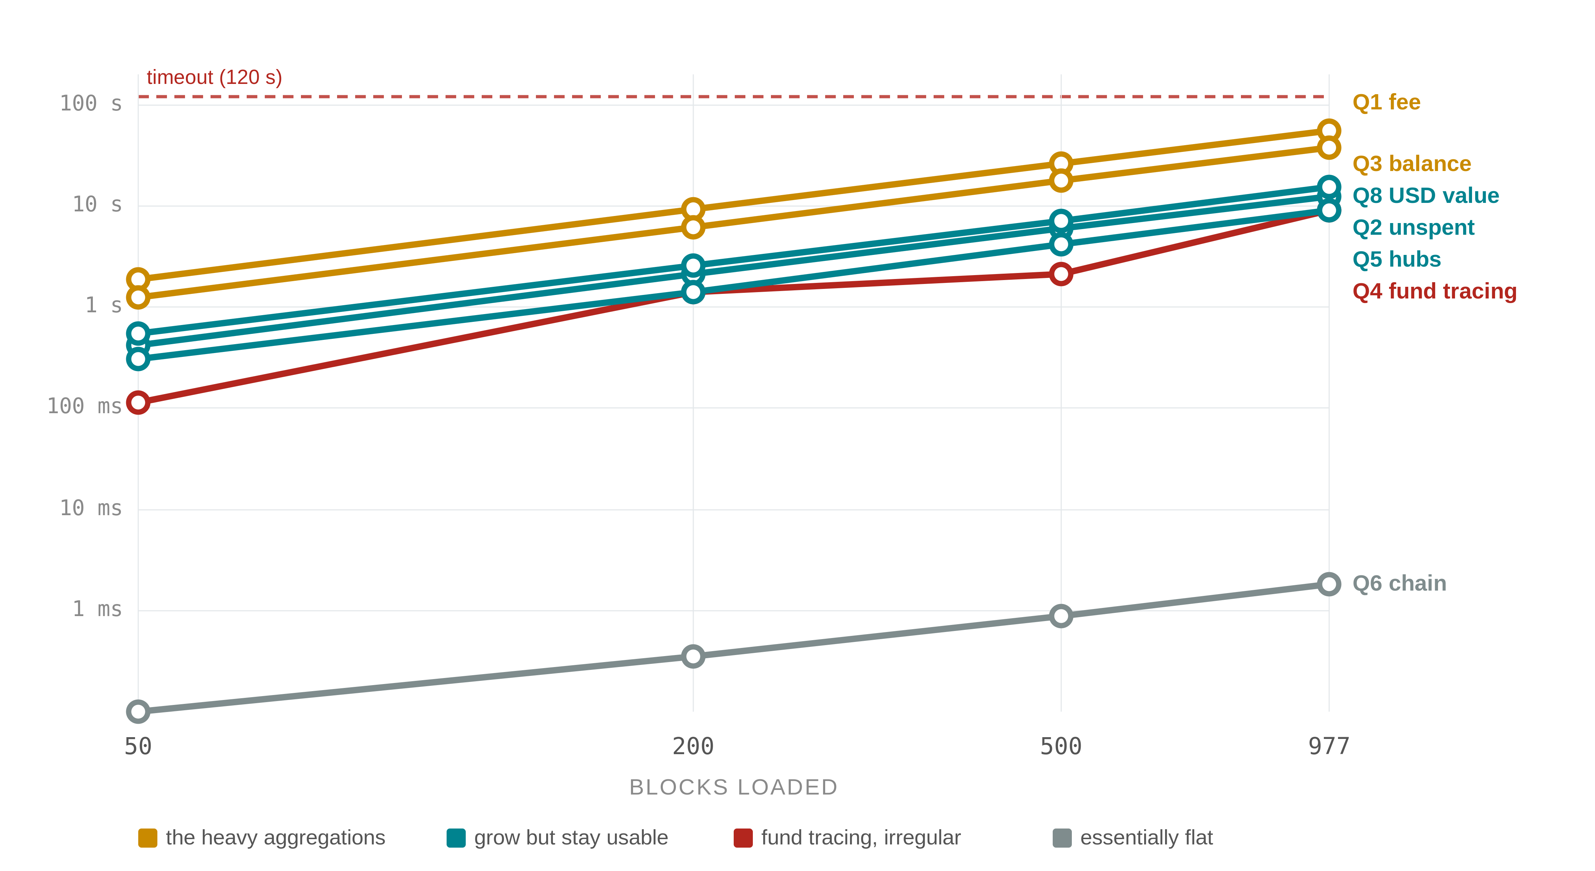
Scalability · SQLite
Q1 fee · Q3 balance
1-2 s → 40-60 s
30x the time for 19x the data
Q2 · Q5 · Q8
0.3-0.5 s → 9-15 s
grow with the data, stay usable
Q4 fund tracing
0.1 s → 9 s, in jumps
depends on how connected the start is
Q6 main chain
0.07 ms → 1.8 ms
reads only the blocks table, ≤ 977 rows
Which query degrades, and from what size?
NodeCoin · SQLite vs Neo4j
Data Management 2025/2026
Pagina 10

Slide 11
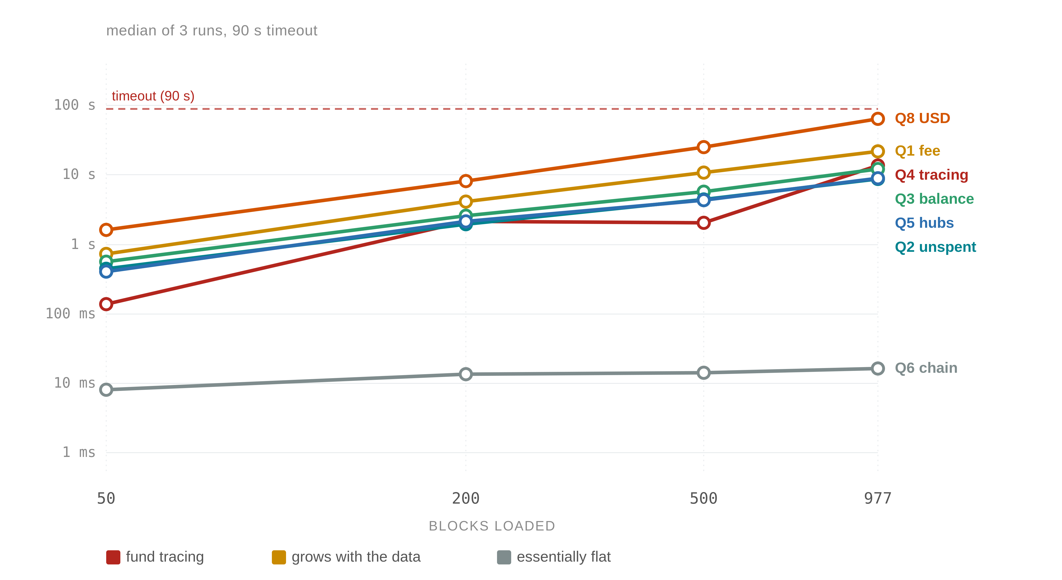
Scalability · Neo4j
Q4 · follows the start address
0.14 s → 13.8 s
start address 2.5k → 56k outputs
the same walk as the SQL query
Q1 · Q2 · Q3 · Q5 · Q8 grow
they touch every output or transaction
20-40x the time for 19x the data
Q6 · stays flat
8 ms → 17 ms
walks only the block nodes, ≤ 977
never touches the millions of outputs
Same shape as SQLite
NodeCoin · SQLite vs Neo4j
Data Management 2025/2026
Pagina 11

Slide 12
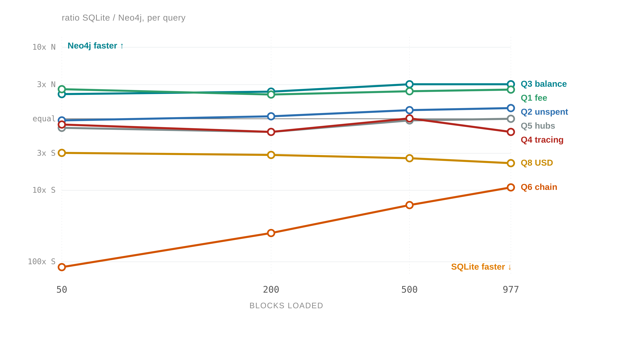
The two engines together
Neo4j side · Q3 · Q1
2-3x faster at every size
the JOIN never gets cheaper
about equal · Q2 · Q5
within 1.5x either way
both scan every output
SQLite side · Q4
1.2x → 1.5x, equal at 500
same walk, SQLite a bit faster
SQLite side · Q8
3x → 4x for SQLite
Cypher sorts the prices per transaction
SQLite side · Q6
117x → 9x, always SQLite
Neo4j fixed cost per query
The query decides the winner, not the size
NodeCoin · SQLite vs Neo4j
Data Management 2025/2026
Pagina 12

Slide 13
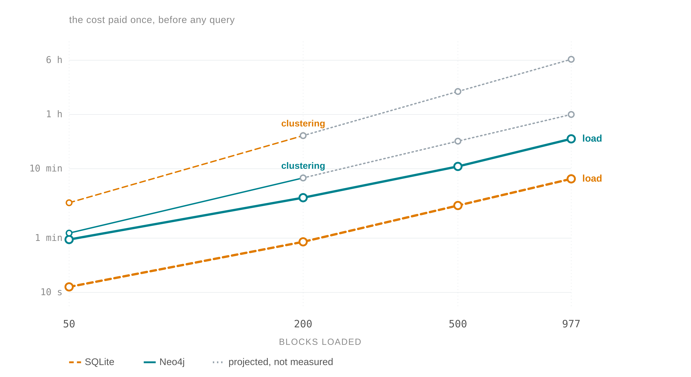
The cost you don't see in query timings
LOADING, PAID ONCE
SQLite
9.4 min · 6.2 GB
Neo4j
40.2 min · 16.3 GB
4.3x slower, 2.6x disk → fast traversals later
WALLETS FOR Q7, BUILT BEFORE THE QUERY
Neo4j
84 min once · then 12.3 s
SQLite
never finishes at 977 blocks
load gap ≈ 4x at every size
each round rereads 276 M rows from disk
NodeCoin · SQLite vs Neo4j
Data Management 2025/2026
Pagina 13

Slide 14
What I take away
PERFORMANCE
SCALABILITY
depends on the query
Neo4j up to 3.7x · SQLite up to 8.4x
the ratios stay flat
size does not change the winner
QUERY LANGUAGE
EASE OF USE
Cypher = patterns, SQL = JOINs
relationships easier to write in Cypher
SQLite = 1 file, 9 min to load
Neo4j = server, 8 GB heap, 40 min
Pay up front (graph) or pay at query time (relational)
Limits 1 laptop · 1 week of data · clustering is a heuristic · embedded vs server
NodeCoin · SQLite vs Neo4j
Data Management 2025/2026
Pagina 14

Slide 15
Live demo
50 transactions of the same data · loads in 2 s instead of 40 min
SQLite
Neo4j Browser
the tables, with real rows
Q1 to Q8 with one click
free SQL editor
the graph, visual and clickable
fund tracing as a traversal
the clustering on the graph
NodeCoin · SQLite vs Neo4j
Data Management 2025/2026
Pagina 15

